Slide 1
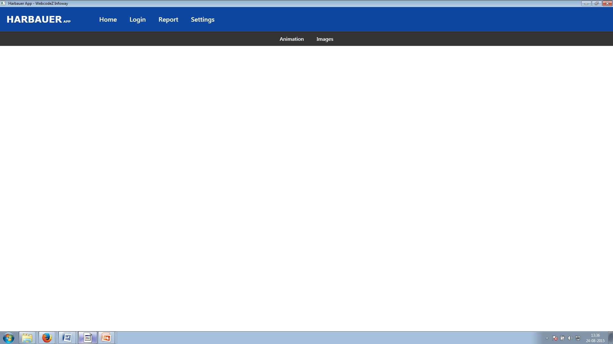
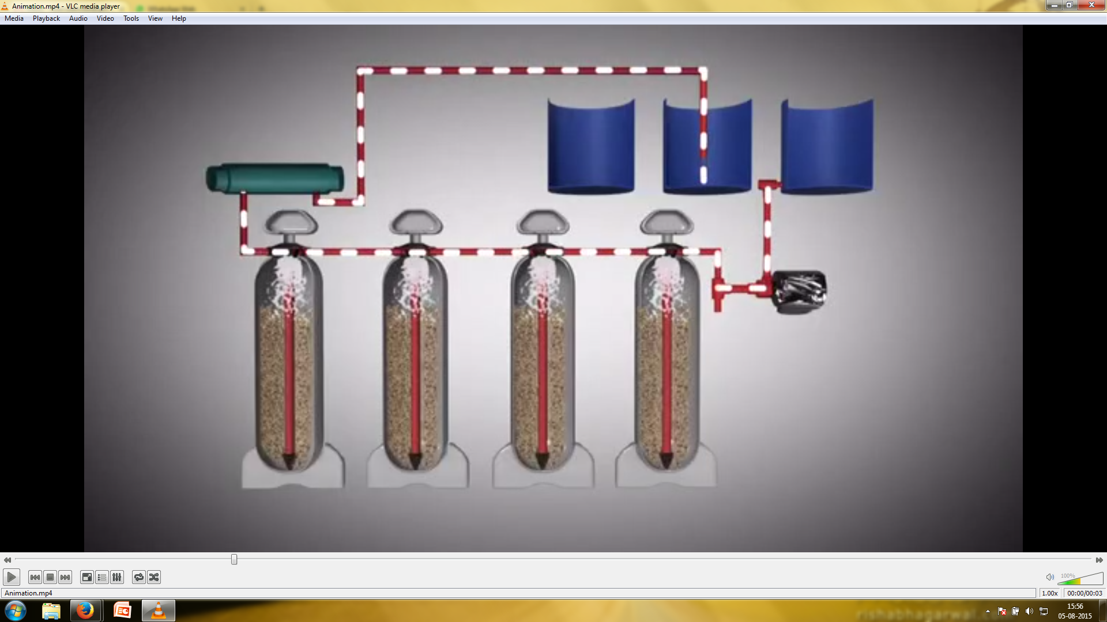
Arsenic Contamination : Below Permissible Levels Safe Drinking Water
Iron Contamination : Below Permissible Levels Safe Drinking Water
Bacteriological Contamination : Negative Safe Drinking Water

